Slide 1
Mobile Application Development
Semester Project Guideline

Slide 2
What does Full-stack mean ?
Full-stack includes Front-end, Back-end, Mobile Development and Deployment. All in one.
In this semester project, this is our aim.
We are already familiar with TypeScript, JavaScript and Angular. That is all we need to build a full stack solution.
Notes:
First of all, we need to understand what Parent, Child, and Sibling components are.

Slide 3
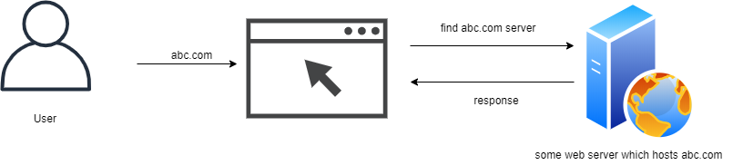
Let talk a little about How Apps/Website work?
Notes:
First of all, we need to understand what Parent, Child, and Sibling components are.

Slide 4
How most mobile apps work?
Most mobile apps are often linked to a web server.
The web server could be any server written in any language e.g. PHP, C#, Java, Node.js, Golang, Rust, Elixir, C++.
The mobile app usually communicates with the web server / backend using REST API.
Notes:
First of all, we need to understand what Parent, Child, and Sibling components are.

Slide 5
How most mobile apps work?
REST API is a protocol that allows us to communicate with a server using HTTP.
REST API is basically GET, PUT, POST, DELETE http methods.
In previous class, we used REST apis. In one example, we displayed Quotes, and in another, we used Github’s REST api and displayed list of repositories.
Notes:
First of all, we need to understand what Parent, Child, and Sibling components are.

Slide 6
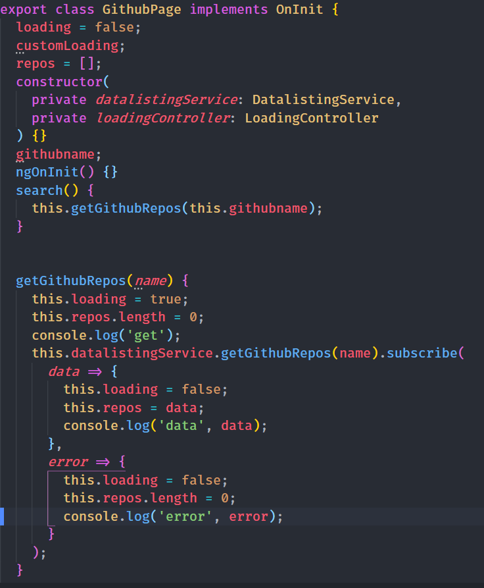
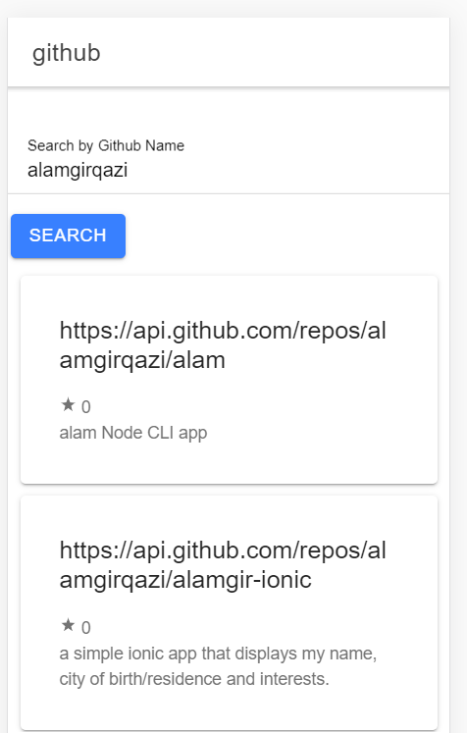
How most mobile apps work?
Notes:
First of all, we need to understand what Parent, Child, and Sibling components are.

Slide 7
How most mobile apps work?
REST API is a protocol that allows us to communicate with a server using HTTP.
REST API is basically GET, PUT, POST, DELETE http methods.
In previous class, we used REST apis. In one example, we displayed Quotes, and in another, we used Github’s REST api and displayed list of repositories.
Notes:
First of all, we need to understand what Parent, Child, and Sibling components are.

Slide 8
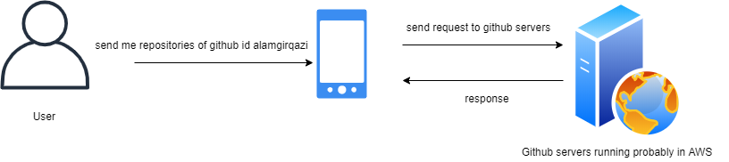
Whats happening here?
We sent this HTTP request https://api.github.com/users/alamgirqazi/repos
Notes:
First of all, we need to understand what Parent, Child, and Sibling components are.

Slide 9
So how can we set this up ?
In order to set this up on our own, we will need
a Mobile App ( Ionic, Angular ).
a web server ( Node.js ).
A Web App using Angular (entirely optional)
This how most companies build their applications. All this tech using just JavaScript language.
Notes:
First of all, we need to understand what Parent, Child, and Sibling components are.

Slide 10
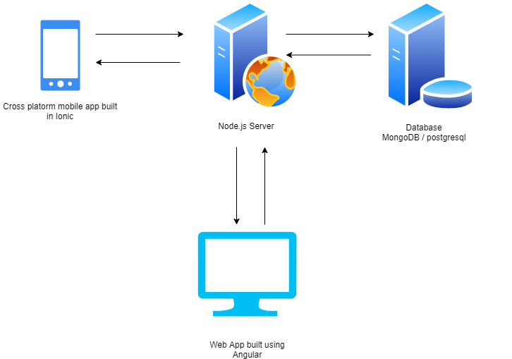
Full Stack Solution
Notes:
First of all, we need to understand what Parent, Child, and Sibling components are.

